Slide 1

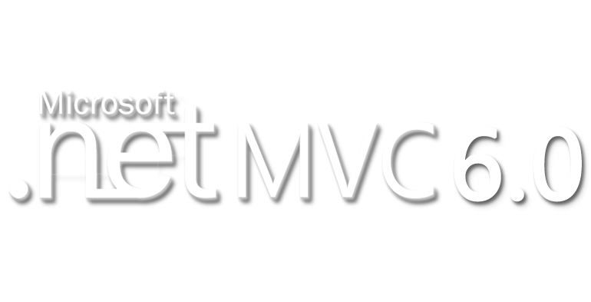


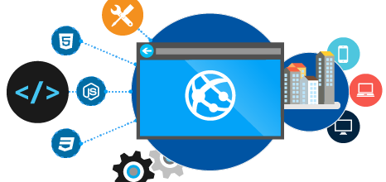
ASP.NET 5 (vNext)
Lean .NET stack for building modern web apps
SoftUni Team
Technical Trainers
Software University
http://softuni.bg

Slide 2

Table of Contents
Introduction to ASP.NET 5
What is Different in ASP.NET 5?
Rewritten, Flexible, Cross-Platform
Middlewares and IoC built-in
Grunt and Bower in ASP.NET 5 templates
View Components
Web API in ASP.NET MVC 6
Entity Framework 7
ASP.NET WebForms 4.6

Slide 3
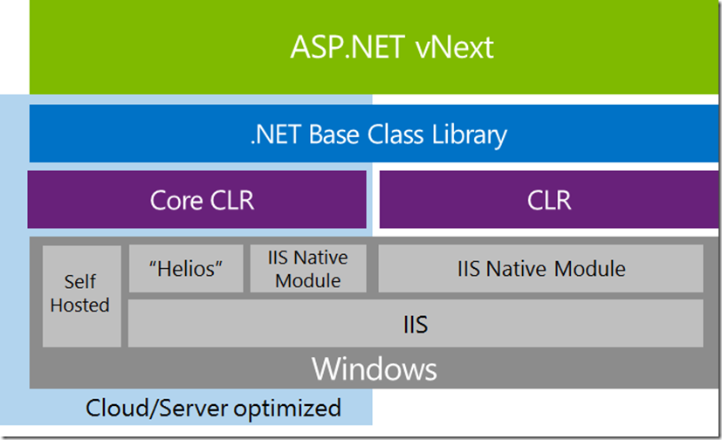
Introduction to ASP.NET 5

Slide 4
Introduction to ASP.NET 5
Lean .NET stack for building modern web apps
Built from the ground up
Unified programming model that combines MVC, Web API, and Web Pages
Consists of modular components with minimal overhead
Open source in GitHub from the beginning
https://github.com/aspnet/Mvc
Changes based on customer requests and feedback

Slide 5
Introduction to ASP.NET 5
New flexible and cross-platform runtime
New modular HTTP request pipeline
Cloud-ready environment configuration
Ability to self-host or host on IIS
Ability to see changes without re-building the project
Side-by-side versioning of the .NET Framework
New tools in Visual Studio 2015

Slide 6
What is Different in ASP.NET 5?

Slide 7
Flexible, Cross-Platform
In the past, the .NET Framework was delivered as a single, all-encompassing installation
Features were added but rarely removed
The size of the framework continually grew
ASP.NET 5 can be run on:
Full .NET CLR – 200 MB, update everything
Best for backward compatibility
Core CLR (cloud-optimized runtime) – 11 MB
Include only those features that you need
Cross-Platform CLR – Not ready, yet. Use Mono.

Slide 8

Different Runtimes
ASP.NET 5 (CLR) and ASP.NET Core 5 (CoreCLR)

Slide 9
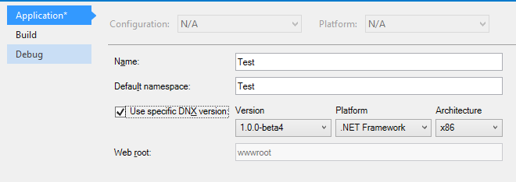
Choosing Runtime
By default, new Visual Studio projects use the full .NET CLR
You can specify the Core CLR in the configuration properties for your project

Slide 10
Flexible, Cross-Platform (2)
ASP.NET 5 – Faster Development Cycle
Features are shipped as packages
Use just features needed
Framework ships as part of the application
Zero-day security bugs patched
Same code runs in development and production
Edit code and refresh browser
Develop with VS, third-party or cloud editors

Slide 11

Host Anywhere
The ASP.NET 5 applications can be deployed on IIS or can be self-hosted (in own process)
If Core CLR is used every single dependency is bundled within the deployment package
Not dependent on .NET framework version
Different versions of .NET side-by-side
Different applications may work on different runtime versions
To run different versions, you must target the Core CLR

Slide 12

Better Performance
Faster startup times
Lower memory
The platform (ASP.NET 5) is modular
You can turn features on and off as you want

Slide 13
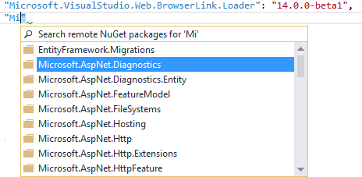
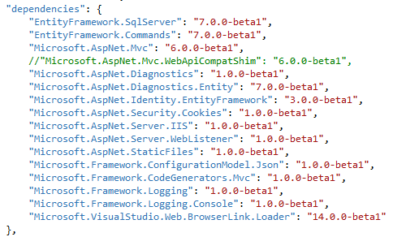
Package Management
ASP.NET 5 introduces a new, lightweight way to manage dependencies in your projects
No more assembly references
Instead referencing NuGet packages
project.json file

Slide 14
Middlewares
Improved HTTP performance
New HTTP request pipeline that is lean and fast
The new pipeline also supports OWIN
You choose what to use in your application
By registering middlewares
public void Configure(IApplicationBuilder app, IHostingEnvironment env,
ILoggerFactory loggerfactory)
{
app.UseErrorHandler("/Home/Error");
app.UseStaticFiles();
app.UseIdentity();
app.UseMvc(routes => ...)
}

Slide 15
Custom Middleware
Create middleware class
Register in Startup.cs (IApplicationBuilder)
public class AppHeaderMiddleware {
private readonly RequestDelegate next;
public AppHeaderMiddleware(RequestDelegate next) {
this.next = next;
}
public async Task Invoke(HttpContext context) {
context.Response.Headers.Append("X-Application", "ASP.NET 5");
await this.next.Invoke(context);
}
}
app.UseMiddleware<AppHeaderMiddleware>();
// Register before app.UseMvc(...);

Slide 16

Custom Middleware
Live Demo

Slide 17
Other Improvements
Made cloud-ready
Configuration, session and cache
No code changes for cloud environments
Dependency injection is built into ASP.NET
Register services in Startup.cs
public void ConfigureServices(IServiceCollection services)
{
services.AddScoped<ITimeProvider, TimeProvider>(); }

Slide 18

IoC in ASP.NET 5
Live Demo

Slide 19
Grunt and Bower in ASP.NET 5
Visual Studio 2015 is integrating with Bower
Similar to NuGet for client side packages
JS libraries and CSS packages
Integrating with Grunt
Provide build tasks for client-side purposes
Similar to MS Build for the client side
Compile LESS, SASS
Bundling
Minification, etc.

Slide 20
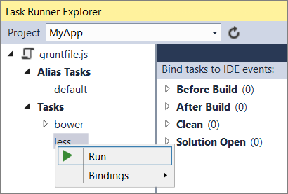
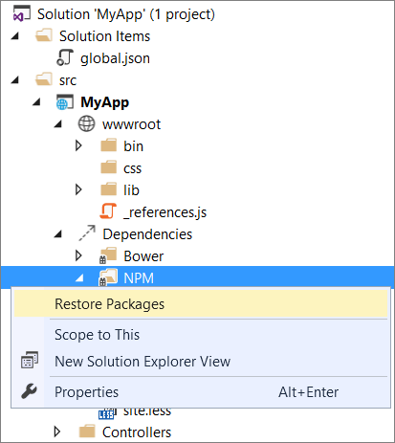
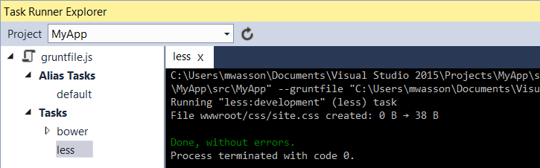
Grunt/Gulp and Bower
Live Demo

Slide 21
View Components
Similar to partial views, but much more powerful
Something like mini-controller
Responsible for rendering a chunk
Some examples for view components usage:
Dynamic navigation menus
Tag cloud
Login panel
Recently published articles
Sidebar

Slide 22
View Components (2)
Consists of two parts:
The class (derived from ViewComponent)
The Razor view located in:
/Views/Home/Components/SideBar/Default.cshtml
/Views/Shared/Components/SideBar/Default.cshtml
More information
www.asp.net/vnext/overview/aspnet-vnext/vc
public class SideBarViewComponent : ViewComponent {
public IViewComponentResult Invoke(int numbers) {
return View();
}
}

Slide 23
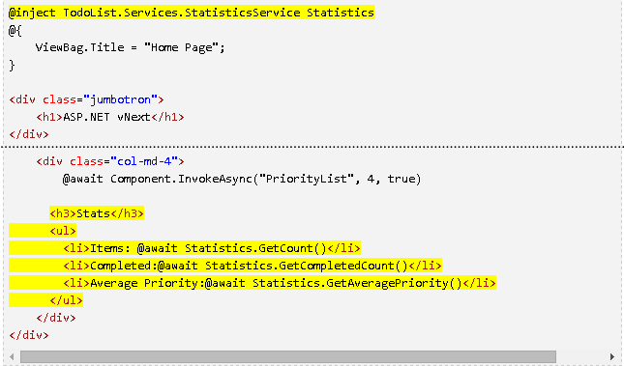
View Components
Live Demo

Slide 24
Web API in ASP.NET MVC 6
MVC, Web API, and Web Pages are merged into a single framework called MVC 6
This merging removes duplication
In ASP.NET MVC 5 there are overlapping features with different implementations
MVC routing – System.Web.Mvc.Routing
WebAPI routing – System.Web.Http.Routing
Currently only MVC and WebAPI are unified
Web Pages will be added in a later release

Slide 25

Web API in ASP.NET MVC 6
Live Demo

Slide 26
Entity Framework 7
New platforms (in addition to .NET)
Windows Phone, Windows Store
ASP.NET 5 (.NET core)
Mac and Linux
New data stores (in addition to relational)
Non-relational data stores
Not a magic abstraction but option to use common EF functionality in all data stores
SQL Server, SQLite, Azure Table Storage, Redis, In Memory (for testing)
https://github.com/aspnet/EntityFramework

Slide 27
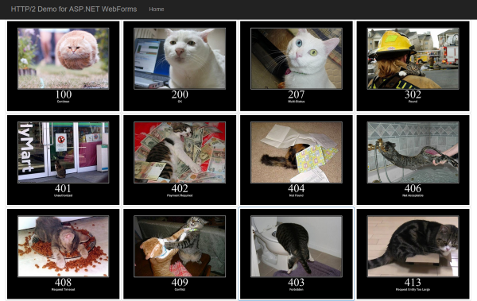
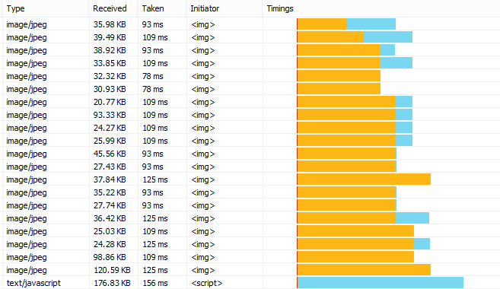
ASP.NET WebForms 4.6
HTTP/2
Roslyn Code Dom Compilers
Leverage the new C# 6 features
Async Model Binding (Leverage EF async)

Slide 28

Summary
Introduction to ASP.NET 5
What is Different in ASP.NET 5?
Web API in ASP.NET MVC 6
Entity Framework 7
ASP.NET WebForms 4.6

Slide 29









ASP.NET 5
https://softuni.bg/courses/asp-net-mvc/

Slide 30
License
This course (slides, examples, demos, videos, homework, etc.) is licensed under the "Creative Commons Attribution-NonCommercial-ShareAlike 4.0 International" license
Attribution: this work may contain portions from
"Visual Studio 2015 and ASP.NET 5" seminar by Telerik Academy under CC-BY-NC-SA license

Slide 31




Free Trainings @ Software University
Software University Foundation – softuni.org
Software University – High-Quality Education, Profession and Job for Software Developers
softuni.bg
Software University @ Facebook
facebook.com/SoftwareUniversity
Software University @ YouTube
youtube.com/SoftwareUniversity
Software University Forums – forum.softuni.bg

